Slide 1

Notes:
Good morning Uncle. Welcome to our presentation on the 'Integrated Market Diagnosis of Telecom Services in India.' Today, we will move beyond surface-level metrics to understand the structural realities of the market. Our analysis focuses on three critical questions: What is currently failing in the consumer experience? Why are these failures occurring despite technological advancements? And finally, how can we fix them using data-driven policy and operational changes.

Slide 2
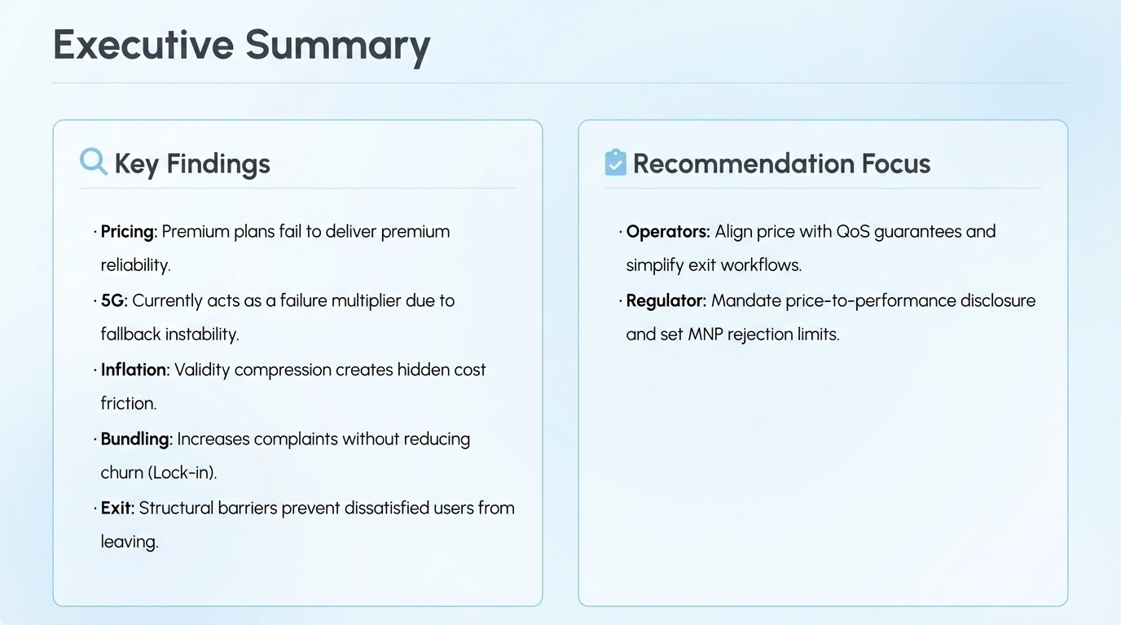
Notes:
To begin, let’s look at the big picture. Our analysis has uncovered five systemic issues. First, there is a 'Premium Illusion' where higher prices do not guarantee better network reliability. Second, 5G is currently acting as a 'failure multiplier' rather than a stabilizer. Third, we see evidence of 'Hidden Inflation' through validity compression. Fourth, service bundling is increasing complaints without reducing churn, effectively acting as a lock-in mechanism. Finally, when users try to leave, they face structural 'Exit Friction.'
Our recommendations focus on two areas: Operators must align pricing with measurable Quality of Service (QoS) guarantees, while the Regulator (TRAI) must mandate transparency in pricing and enforce stricter limits on Mobile Number Portability (MNP) rejections.

Slide 3

Notes:
Let’s dive into our first pillar: 'Pricing vs. Performance.' The central question here is whether paying more actually buys a consumer a better network experience. We call this phenomenon 'The Premium Illusion'.

Slide 4

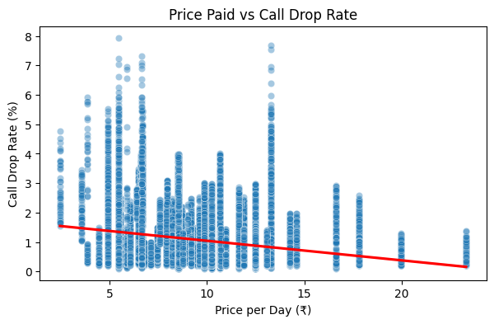

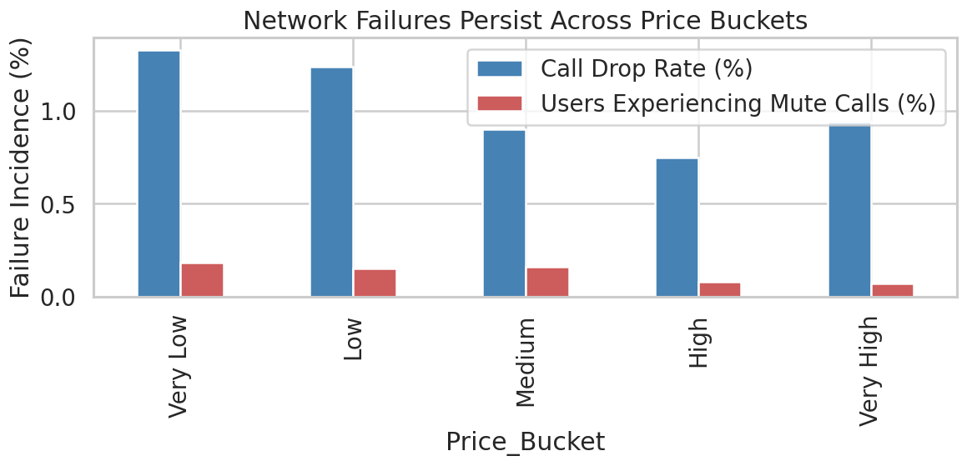
Pricing vs Performance: Diagnosis
WHAT (Observed Patterns)
Moving from Very Low to High price plans reduces median call drop rates by only 38%, with failures reappearing in Very High plans, indicating diminishing returns on price.
Price per day shows weak negative correlation with call drop rate (|r| < 0.3) and near-zero correlation with mute calls, indicating price is a poor predictor of network reliability.
Operator-level analysis shows ≥0.5% median call drop rates even in premium plans, with some operators (e.g., Vi) exhibiting higher failure rates at higher prices, contradicting premium service expectations.
Notes:
Here is what the data tells us. If you look at the scatter plot on the top right, you will see a weak correlation between the price paid per day and call drop rates. In fact, moving from 'Very Low' to 'High' price plans only reduces median call drop rates by roughly 38%, which is insufficient for the price hike.
Furthermore, as seen in the bottom chart, network failures—specifically call drops and mute calls—persist across all price buckets. Even users paying for 'Very High' tiers face significant service degradation. This indicates that price is currently a poor predictor of network reliability.

Slide 5
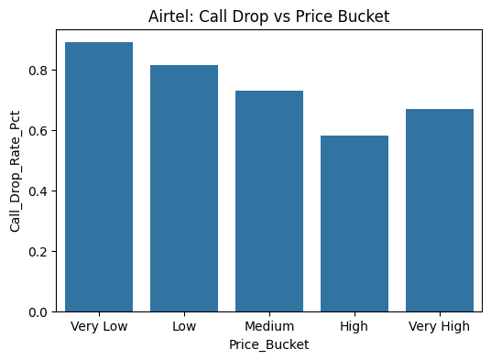
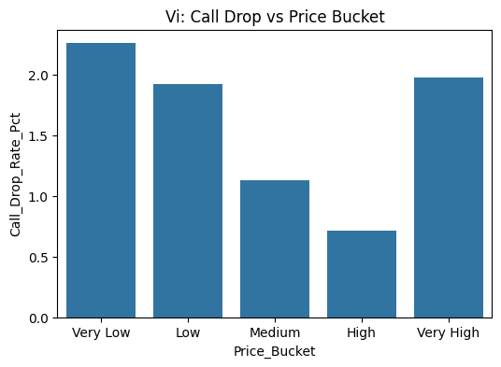

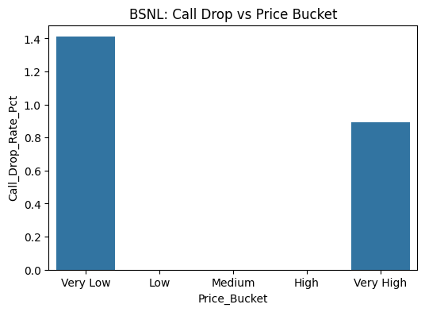
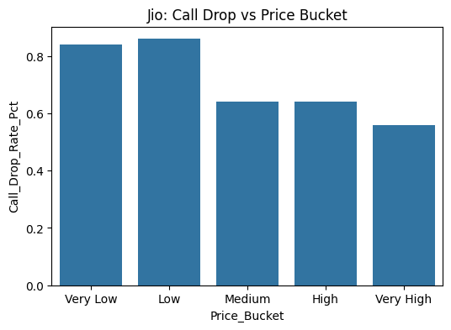
Pricing vs Performance: Diagnosis
WHY (Root Cause)
Across price buckets, median call drop rates decline only marginally from ~1.3% (Very Low) to ~0.7-0.9% (High / Very High); a reduction of less than 0.6% points, showing price uplift does not proportionally improve reliability.
In the Very High price bucket, call drop rates increase again (≈ 0.9%) compared to the High bucket (≈ 0.7%), indicating pricing does not guarantee sustained network performance gains.
The persistence of ≥ 0.7% call drop rates even in premium plans suggests failures are driven by systemic network constraints (capacity, congestion, spectrum reuse) rather than individual plan pricing.
Notes:
Why is this happening? The root cause is that premium pricing is masking systemic infrastructure constraints rather than fixing them. As you can see in the bar charts for Airtel, Vi, BSNL, and Jio, median call drop rates often plateau or even slightly increase in the highest price tiers (as seen in the 'Very High' bucket data).
This suggests that failures are driven by network-wide issues like congestion, spectrum reuse, and capacity limits. Simply put, paying more mitigates consumer perception, but it does not mitigate the physical limitations of the network.

Slide 6


Solutions: Pricing & Performance
For Operators
For Regulator (TRAI)
Align premium pricing with measurable QoS guarantees (e.g., max call drop thresholds).
Mandate price-to-performance disclosure (₹/day vs median failure rates).
Introduce network-performance-linked rebates for premium users.
Require operators to publish QoS by price tier, not just network-wide averages.
Notes:
To address this 'Premium Illusion,' we propose specific actions. Operators must stop treating price as a proxy for quality and instead introduce 'Network-Performance-Linked Rebates'—if the network fails, the premium user gets a refund.
For the Regulator, we recommend mandating 'Price-to-Performance Disclosure.' Operators should be required to publish QoS metrics by price tier, not just as a network-wide average, so consumers know exactly what reliability they are buying.

Slide 7
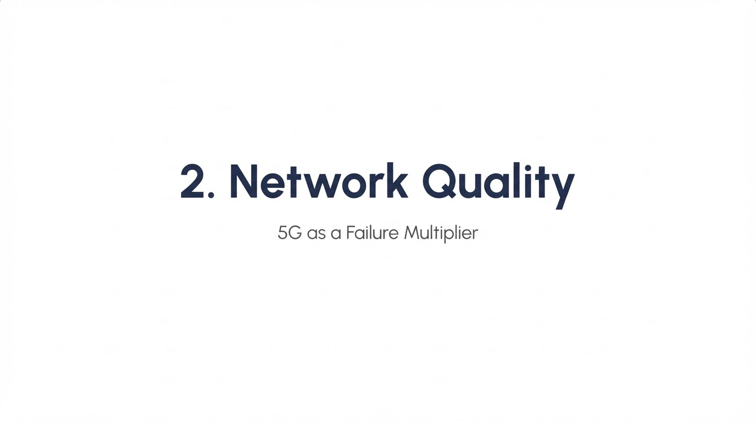
Notes:
Moving to our second pillar: Network Quality. Specifically, we examined the impact of the transition to 5G. Contrary to the marketing hype, our diagnosis identifies 5G as a 'Failure Multiplier' in its current state.

Slide 8
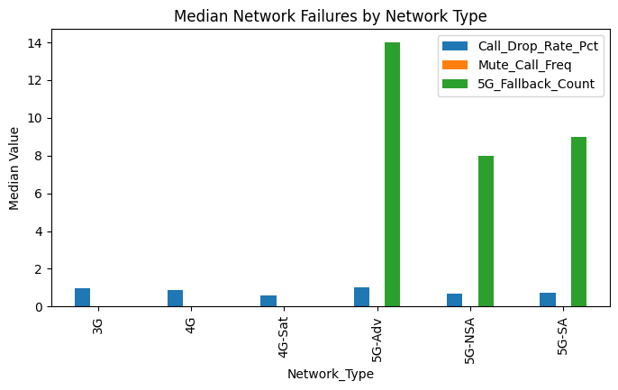
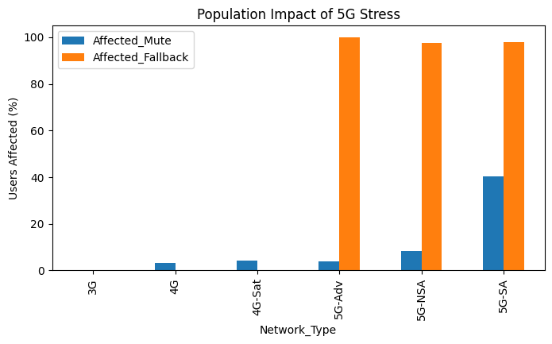
5G Quality: Diagnosis
WHAT (Observed Patterns)
Median 5G→4G fallback counts rise sharply to ~14 events for 5G-Advanced and remain high at ~8–9 events for 5G-NSA and 5G-SA, compared to ~0 for 3G and 4G users.
Mute call exposure increases with 5G adoption, with ~40% of 5G-SA users affected, ~8% for 5G-NSA, and less than 5% among 4G users.
Nearly the entire 5G user base is impacted by fallback, with ~98–100% of users on 5G-Advanced, 5G-NSA, and 5G-SA experiencing fallback events, while 3G and 4G show negligible impact.
Notes:
The data on this slide is stark. The green bars in the top chart show that 5G users experience a massive spike in 'Fallback' events—where the phone drops from 5G to 4G. This happens roughly 14 times more often for 5G-Advanced users compared to 4G users.
The bottom chart confirms the population impact: nearly 98% to 100% of the 5G user base is affected by these fallback events. This instability leads to a secondary issue shown in orange: increased mute call exposure. Essentially, the promise of high speed is coming at the cost of basic voice stability.

Slide 9
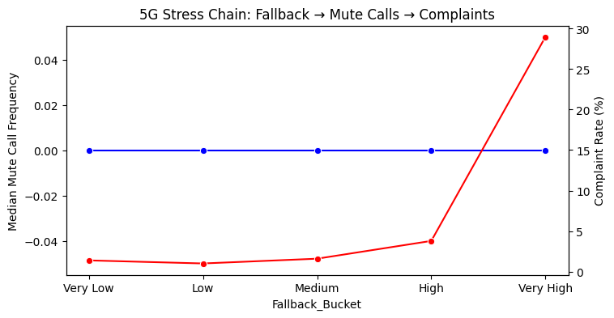
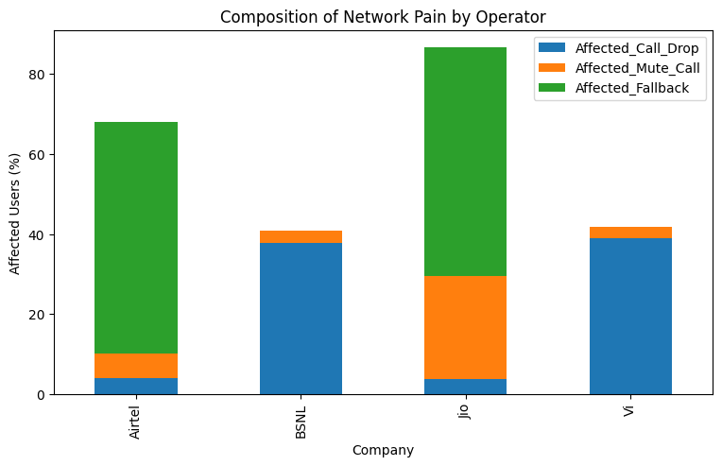
5G Quality: Diagnosis
WHY (Root Cause)
As fallback intensity increases from Very Low to Very High, complaint rates jump sharply from ~2-4% to ~29-30%, while median mute call frequency remains flat at 0, indicating complaints are triggered by fallback stress rather than isolated voice faults.
Operators with the highest fallback exposure also show the highest overall network pain, with fallback affecting ~58-60% of Airtel users and ~57-58% of Jio users, dominating over call drops and mute calls combined.
The stacked operator view shows fallback contributing the single largest share of network pain for 5G-led operators, exceeding ~50% of affected users, confirming that instability during network handovers is the primary failure mechanism rather than standalone call drops.
Notes:
Why is this causing so much dissatisfaction? The line graph at the top illustrates the 'Stress Chain.' As fallback intensity increases (moving right on the x-axis), complaint rates (the red line) spike sharply from roughly 2-4% to nearly 30%.
The fallback mechanism itself destabilizes the connection, triggering mute calls and subsequent complaints. The operator breakdown below shows that for 5G-led operators like Jio and Airtel, fallback issues now contribute the single largest share of network pain, outweighing traditional coverage holes. This is a transitional maturity issue.

Slide 10
Solutions: 5G Quality
For Operators
For Regulator
Pause aggressive expansion in weak clusters; prioritise handover stability.
Introduce 5G voice-readiness certification before mass marketing.
Separate marketing rollout from voice reliability certification.
Enforce reporting of fallback frequency as a QoS metric.
Notes:
To fix this, Operators need to pause aggressive expansion in weak clusters and prioritize 'handover stability' over raw coverage area. They must separate marketing rollouts from actual voice reliability certifications.
Simultaneously, the Regulator should introduce a '5G Voice-Readiness Certification' that operators must pass before mass marketing these services. Furthermore, fallback frequency must be reported as a standard Quality of Service metric.

Slide 11
3. Hidden Inflation
Pricing Design as Customer Friction
Notes:
Our third pillar addresses 'Hidden Inflation.' This is not about the headline price of a plan, but how the design of the plan itself—specifically its validity duration—creates friction and extra cost for the consumer.

Slide 12
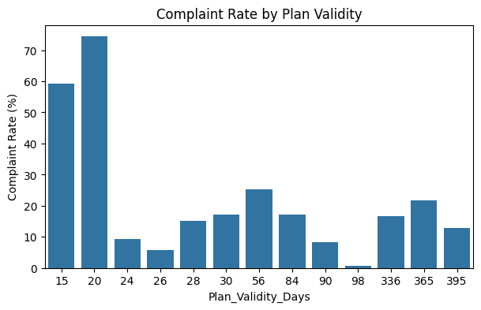
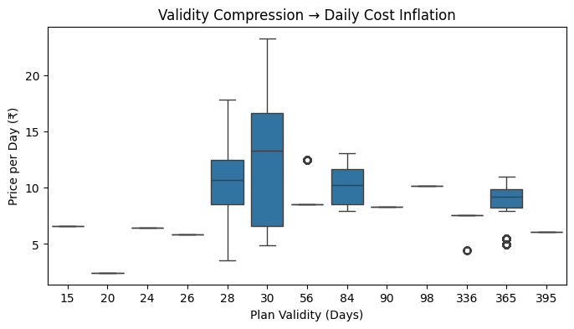
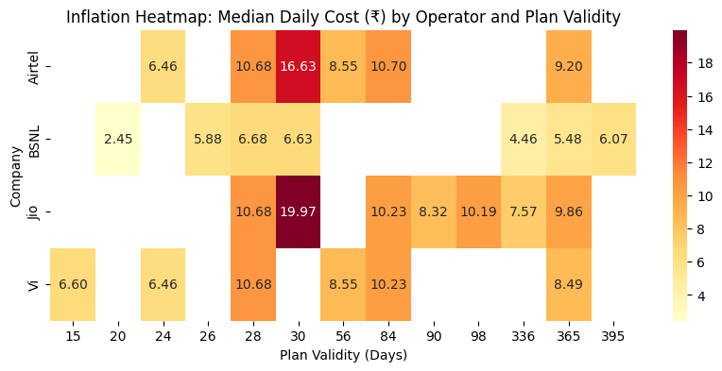
Hidden Inflation: Diagnosis
WHAT (Observed Patterns)
Complaint rates peak at short plan validities, reaching ~75% for 20-day plans and ~60% for 15-day plans, compared to below ~20% for most plans with validity ≥ 56 days.
Median daily price rises sharply due to validity compression, with 28-30 day plans showing median daily costs of ~₹10-₹16, versus ~₹8-₹10 for 84-365 day plans.
Operator-level heatmaps show the most severe daily cost inflation at 28-30 days, with Jio peaking at ~₹19.97/day and Airtel at ~₹16.63/day, while longer plans consistently remain below ~₹10/day.
Notes:
We observed a clear pattern: complaint rates peak at short validity periods. As shown in the top chart, complaints skyrocket to 60-75% for plans with 15-to-20-day validities.
The heatmap on the bottom right explains the financial impact. The red zones indicate that plans with 28-30 day validity have the highest median daily cost (up to ₹19.97/day for some operators). This 'validity compression' forces users to recharge more often, driving up the effective cost of service significantly compared to longer-term plans.

Slide 13
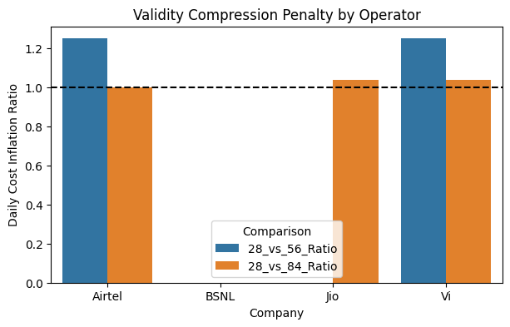
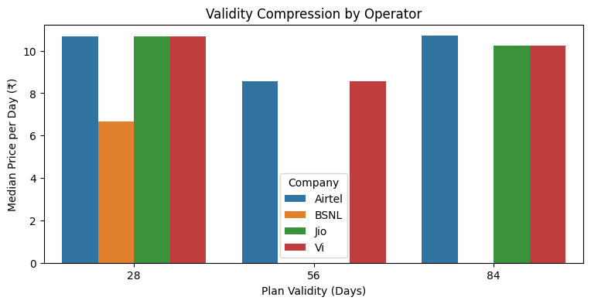
Hidden Inflation: Diagnosis
WHY (Root Cause)
Validity compression creates a measurable daily cost penalty, with 28-day plans costing ~25% more per day than 56-day plans for Airtel and Vi, as shown by inflation ratios of ~1.25.
The penalty disappears when validity extends, with 28 vs 84-day ratios returning to ~1.0 across operators, confirming inflation is driven by shortened validity rather than absolute price.
Median daily prices remain elevated at 28 days (~₹10-₹11 for Airtel, Jio, and Vi) but drop to ~₹8-₹9 at 56 days and stabilize further at 84 days, demonstrating a decrease via compressed plan duration.
Notes:
The root cause here is an artificial penalty on flexibility. The top chart shows a 'Daily Cost Inflation Ratio' of about 1.25 for 28-day plans compared to 56-day plans. This means users pay a 25% premium just for the 'privilege' of a monthly cycle.
This penalty disappears when you move to 84-day plans, confirming that the inflation is structurally driven by the operator's pricing strategy to maximize Average Revenue Per User (ARPU) on lower-commitment plans. It increases the cognitive and financial burden on the most vulnerable value-seeking users.

Slide 14
Solutions: Hidden Inflation
For Operators
For Regulator
Offer standardised 30/90/365-day plans without artificial compression.
Mandate disclosure of effective daily price in all advertisements.
Clearly communicate effective daily cost at point of sale.
Flag repeated short-validity recharges as a consumer protection concern.
Notes:
The solution is transparency and standardization. Operators should offer standardized 30, 90, and 365-day plans to eliminate the '28-day trap.'
Crucially, the Regulator must mandate the disclosure of the 'Effective Daily Price' in all advertisements. Consumers should be able to see clearly that a 'cheaper' short-term plan actually costs them considerably more per day than a long-term one.

Slide 15
4. VAS Bundling
Value Addition or Lock-In Strategy?
Notes:
Next, we look at Value-Added Services (VAS) Bundling. The industry markets these bundles as 'more value,' but our analysis asks: Is this value addition, or is it a lock-in strategy?

Slide 16
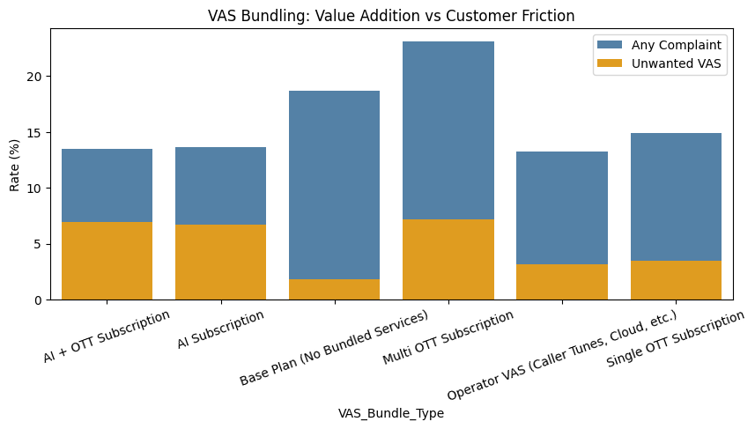
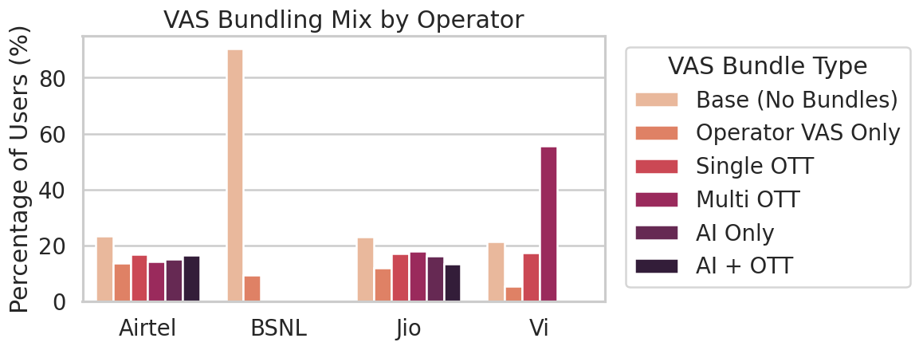
VAS Bundling: Diagnosis
WHAT (Observed Patterns)
Complaint rates rise with bundle complexity, increasing from ~13-14% for AI-only and AI+OTT plans to ~23% for Multi-OTT bundles, despite these being premium offerings.
Unwanted VAS complaints remain material across all bundles, contributing ~6-7% of users in AI-based and Multi-OTT plans and ~3-4% even in Operator VAS and Single OTT bundles.
Despite higher dissatisfaction, churn impact does not escalate proportionally, as operators with heavier premium bundling retain large user shares, such as ~56% of Vi users on Multi-OTT bundles and ~15-18% distribution across advanced bundles for Airtel and Jio.
Notes:
The data suggests that complexity breeds dissatisfaction. The chart on the top right shows that as bundles get more complex (e.g., Multi-OTT plans), complaint rates rise to nearly 23%.
Furthermore, we see a persistent issue of 'Unwanted VAS'—represented by the yellow portions of the bars. Even on base plans, users are complaining about services they didn't intend to buy. Despite this high dissatisfaction, these bundles are heavily pushed by operators like Vi and Airtel, as seen in the user mix chart below.

Slide 17
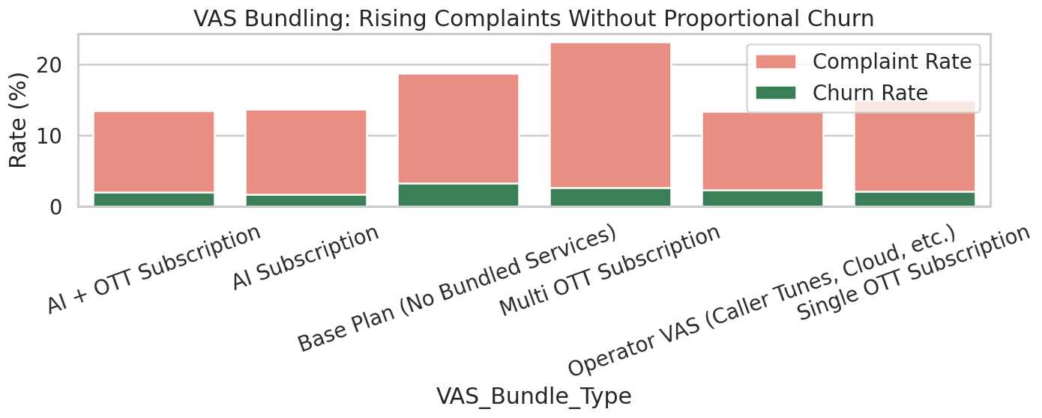
VAS Bundling: Diagnosis
WHY (Root Cause)
Complaint rates rise sharply with bundle complexity, increasing from ~13-14% in AI-based bundles to ~23% in Multi-OTT bundles, while churn remains constrained at ~2-3%, indicating dissatisfaction does not translate into exits.
The complaint–churn gap widens as bundles grow, with a ~20 percentage-point spread in Multi-OTT plans versus ~11-12 points in simpler bundles, suggesting friction is absorbed rather than resolved.
Churn stays flat across all bundle types despite rising complaints, implying exit is structurally harder in complex bundles than in base or single-service plans.
Notes:
Here is the diagnostic insight: Bundles act as a shock absorber for churn. The chart shows that while complaint rates (pink bars) rise sharply with bundle complexity, churn rates (green bars) remain flat.
Why? Because the bundle creates high exit friction. The complexity makes it difficult for a user to untangle their connectivity from their content subscriptions. Thus, the friction effectively traps dissatisfied customers, suppressing churn without resolving the underlying service issues.

Slide 18


Solutions: VAS Bundling
For Operators
For Regulator
Shift from opt-out to explicit opt-in for all VAS.
Enforce separate consent and billing for VAS.
Unbundle OTT and AI services from core connectivity pricing.
Penalise activation of chargeable services without explicit confirmation.
Notes:
To restore genuine consumer choice, Operators must shift from 'Opt-Out' to 'Explicit Opt-In' for all value-added services. OTT and AI services should be unbundled from core connectivity pricing.
The Regulator must enforce separate consent and billing for VAS. Activating a chargeable service without a user's explicit confirmation should be penalized as an anti-consumer practice.

Slide 19
5. Exit Friction
Why Dissatisfied Customers Cannot Leave
Notes:
Finally, we arrive at 'Exit Friction.' If a customer is unhappy with pricing, network, or bundling, they should be able to leave. Our analysis shows that the exit door is effectively jammed.

Slide 20
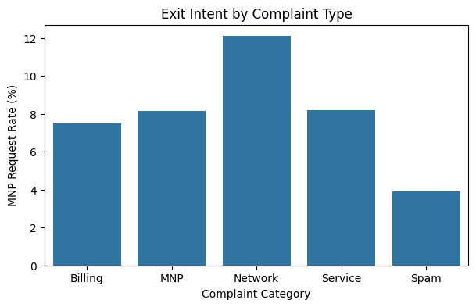
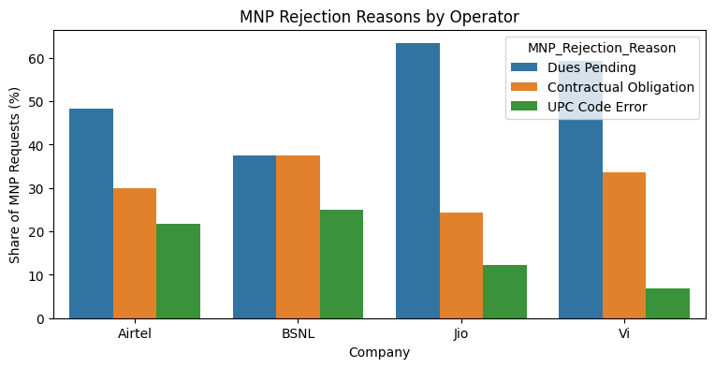
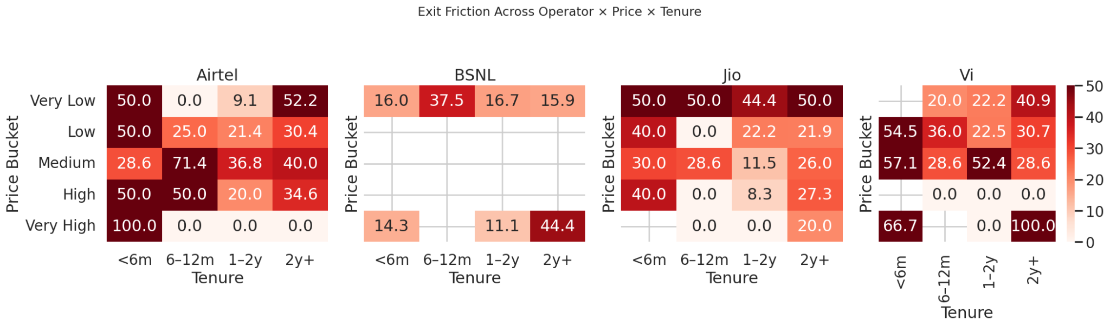
Exit Friction: Diagnosis
WHAT (Observed Patterns)
Only ~20-25% of users who raise complaints proceed to submit MNP requests, and less than ~5% finally churn, indicating a steep drop-off across the exit funnel.
Among MNP requests, “Dues Pending” accounts for ~45-65% of rejections, while “Contractual Obligations” contribute ~25-35%, making administrative barriers the dominant exit blockers.
Exit friction is highest for short-tenure (<6 months) users in low-to-medium price buckets, where rejection rates frequently exceed 40-50%, as shown in the operator × price × tenure heatmap.
Notes:
The 'Exit Funnel' is leaking. Only about 20-25% of users who complain actually file a Mobile Number Portability (MNP) request. Worse, a huge portion of those requests are rejected.
The bar chart shows that 'Dues Pending' and 'Contractual Obligations' are the dominant reasons for rejection—far outweighing technical errors. This friction is most severe for short-tenure users in low-to-medium price buckets, as shown in the red zones of the operator heatmaps.

Slide 21
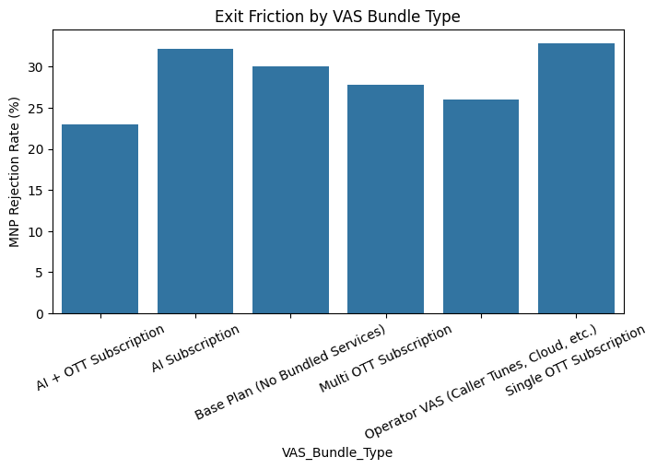
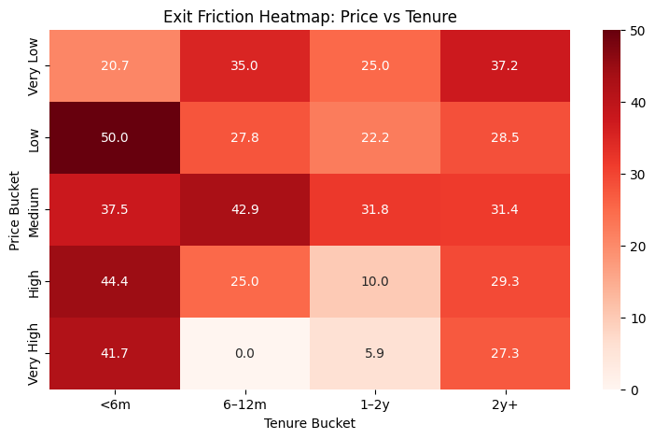
Exit Friction: Diagnosis
WHY (Root Cause)
Exit rejection rates range between 23%-33% across VAS bundle types, peaking for AI Subscription (~32%) and Single OTT (~33%), indicating exit friction is embedded in plan design rather than user behaviour.
Price-Tenure heatmap shows artificially high rejection rates of 40%-50% for short-tenure (<6m) users across multiple price buckets, confirming procedural retention rather than service-led retention.
Long-tenure users (1-2y, 2y+) see near-zero rejection in some buckets, not due to satisfaction but because contractual and billing constraints decay over time, making exit harder early and easier late.
Notes:
Why is this happening? The data confirms that friction is embedded in the plan design. The top chart shows MNP rejection rates peaking for specific bundles like AI and Single OTT subscriptions.
The heatmap below reveals a 'U-shaped' or tenure-biased friction. Rejection rates are artificially high (40-50%) for new users (<6 months) to force them to stay. The system retains customers not by fixing their problems, but by increasing the administrative complexity of leaving.

Slide 22


Solutions: Exit Friction
For Operators
For Regulator
Simplify exit workflows; resolve dues automatically at port-out.
Set maximum MNP rejection thresholds.
Audit operators with abnormal rejection patterns.
Replace lock-in with experience-based retention.
Introduce penalties for repeat exit obstruction.
Notes:
To conclude, we need to dismantle these barriers. Operators must simplify exit workflows—for example, by allowing dues to be resolved automatically at the point of port-out.
The Regulator needs to step in by setting 'Maximum MNP Rejection Thresholds.' Operators showing abnormal rejection patterns, as identified in our heatmaps, should be audited. The goal is to replace 'procedural retention' with 'experience-based retention.'
Thank you.

